Slide 2
Hunter Glanz
Hunter Glanz is an Assistant Professor of Statistics and Data Science at California Polytechnic State University (Cal Poly), San Luis Obispo, California. He regularly teaches courses in Statistical Computing with SAS and R. He enjoys helping organize networking opportunities and hackathon events for students interested in Statistics and Data Science.

Slide 3
Stepping Up Your SAS® Game with Jupyter Notebooks
Hunter Glanz

Slide 4
Statistical Computing
Where have we been?
Why do we need something better?
Project Jupyter is the tool we need (and deserve)!
What is Statistical Computing with Jupyter like
The future of Statistical Computing…

Slide 5
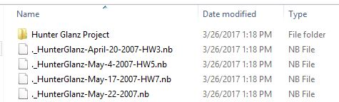
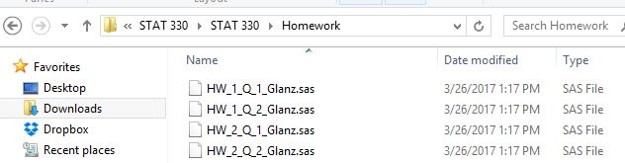
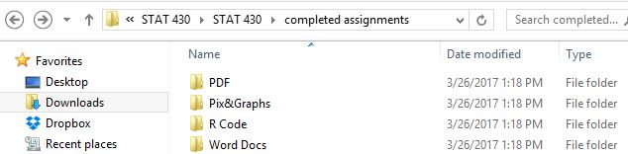
Statistical Computing as an Undergraduate
History Part I

Slide 6
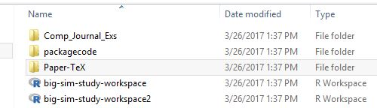
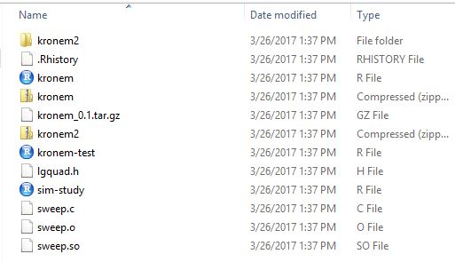
Statistical Computing as a Graduate Student
History Part II
R code & C code
LaTeX files
Bibliography
Image files

Slide 7

Statistical Computing in Industry
History Part III
Same story!
Clean, manipulate, manage data
Summarize and visualize data
Analyze and model data
Synthesize and report
“Some” assembly required…

Slide 8
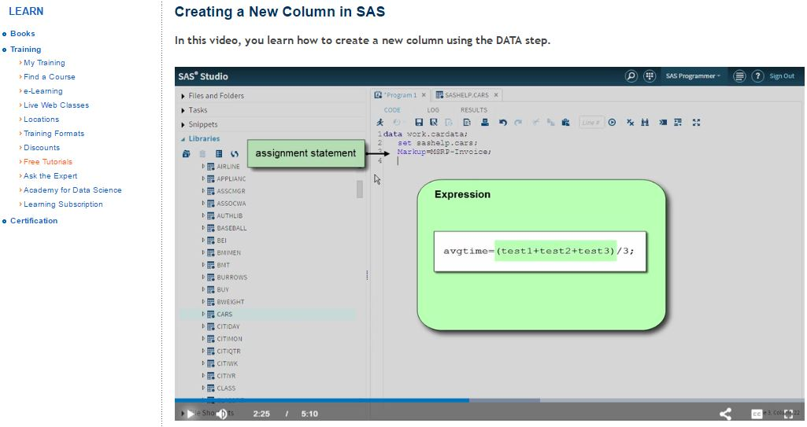
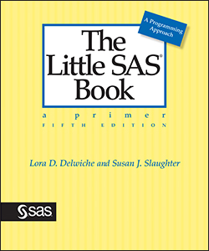
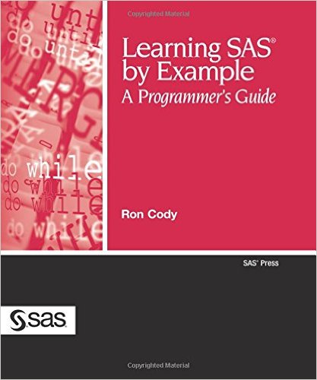
Statistical Computing as an Educator
History Part IV
Traditional lecture notes?
Lecture videos?
Snippets of code?
Live demonstrations?
Learn by doing?

Slide 9
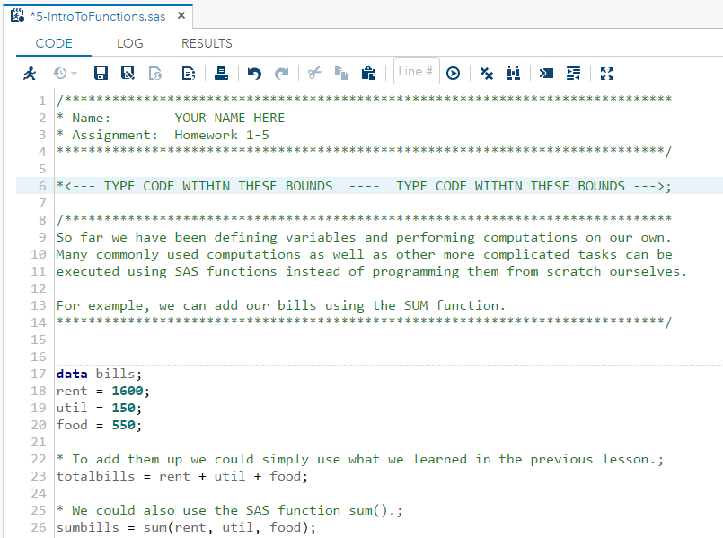
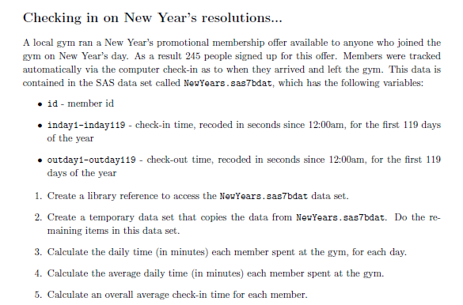
Statistical Computing as an Educator
History Part V
Lab construction ≈ Report/Memo
Many components
Synthesis of exploration and work
Lab completion ≈ Report writing
“Stream of conscious”
Formatting/organization
Commenting

Slide 10

Current Deficiencies
Fragmented collection of files:
Code, text, images, data…
Communication and readability suffer
Unnecessarily large distance between data and story

Slide 11
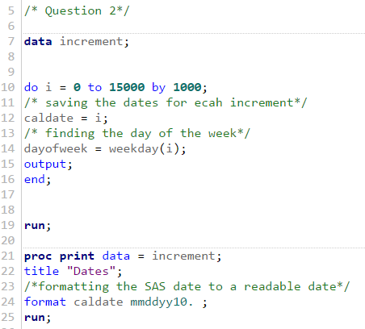
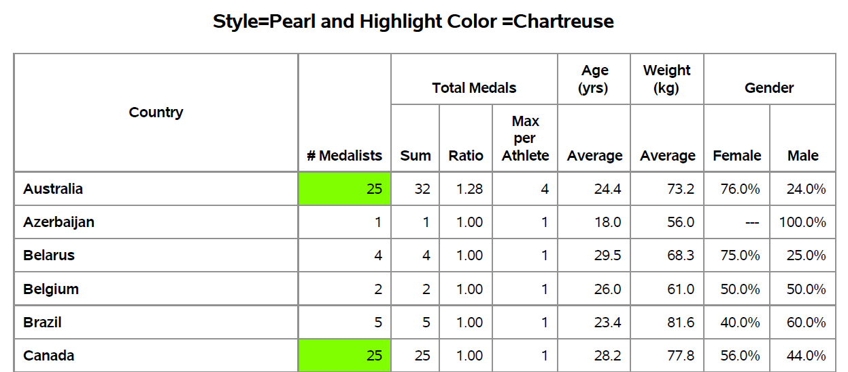
Does Anything Out There Work?
Current Tools
Make computing easier:
IDEs and editors (Emacs, Notebook++, Vim, SAS Studio, RStudio, etc.)
Make report-writing easier:
SAS*, RStudio, LaTeX

Slide 12

Nothing Addresses Our Needs
IDEs/Editors
SAS Studio and Rstudio
Built-in documentation
Color coding, formatting, etc.
Documenting
Rmarkdown & Report-Writing Interface
Highly customizable in LaTeX
None of these integrate coding and documentation!

Slide 13

Capabilities of Ideal Tool
Color coding, formatting, organization of existing tools
Documentation and report writing organically coexist with coding
Streamline the process of:
Exploratory data analysis
Data science
Data journalism
Research
Analytics

Slide 14

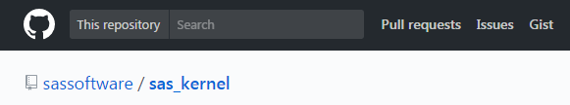
Jupyter Project
Notebook Tour Part I: Getting Started

Slide 15
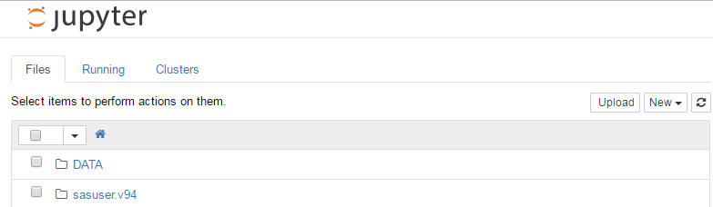
Jupyter Project
Notebook Tour Part II: File Explorer
Essentially a different interface for SAS Studio…

Slide 16
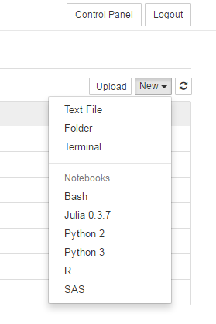
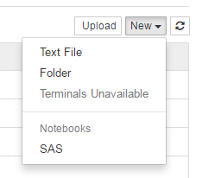
Jupyter Project
Notebook Tour Part III: Starting a Notebook
Personal kernel use vs. SAS University Edition (SAS Studio)
Over 40 languages supported!

Slide 17
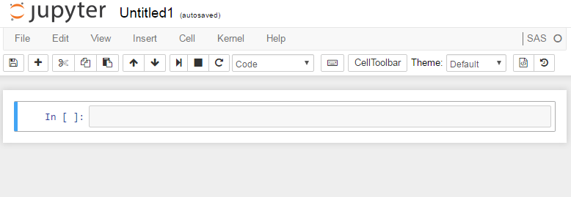
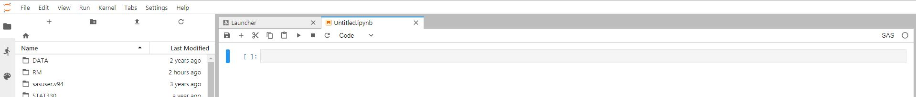
Project Jupyter
Notebook Tour Part IV: A Fresh Notebook

Slide 18
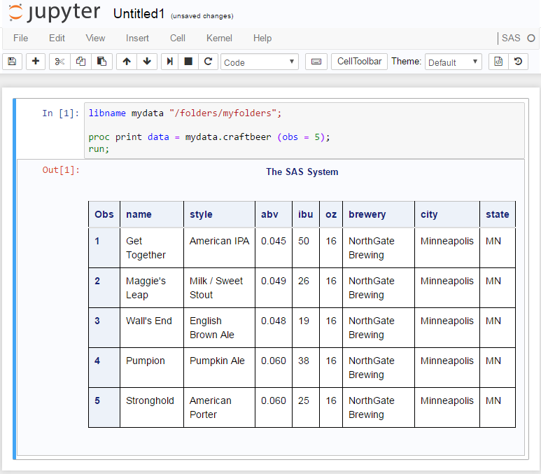
Project Jupyter
Notebook Tour Part V: Code with Inline Output

Slide 19
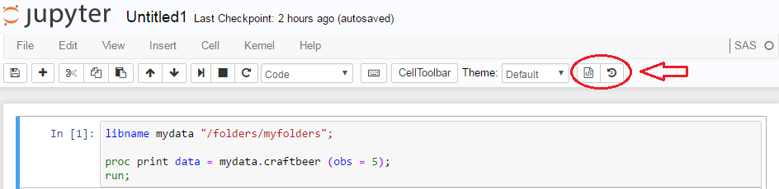
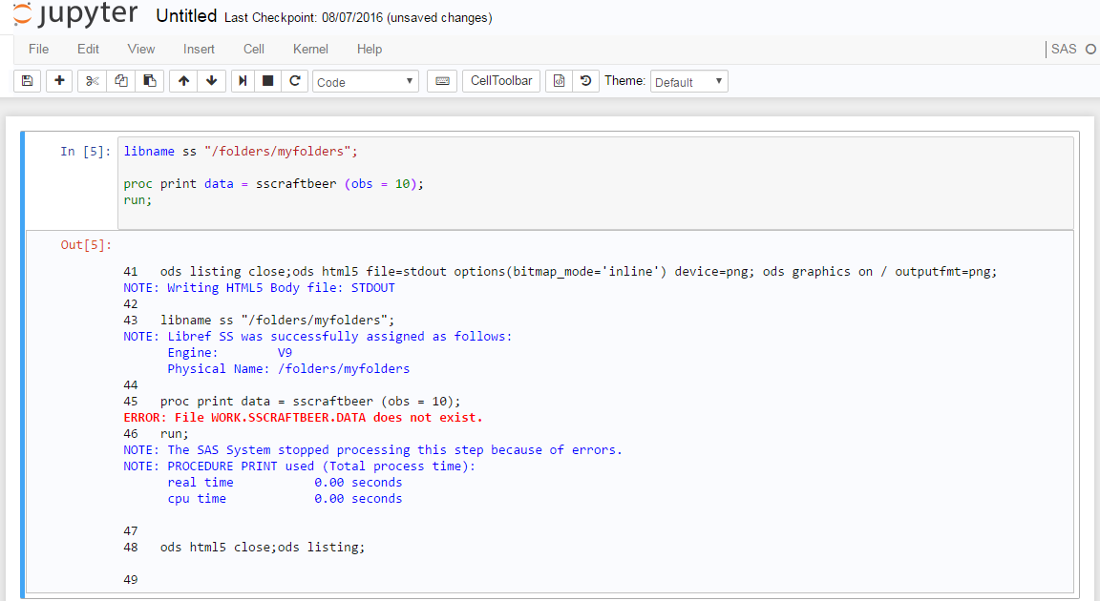
Project Jupyter
Notebook Tour Part VI: The SAS Log

Slide 20
Project Jupyter
Notebook/Lab Tour Part VI: The SAS Log
%showLog or %showFullLog

Slide 21
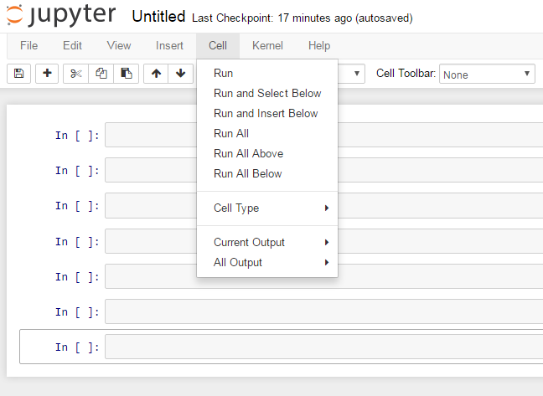
Jupyter Project
Notebook Tour Part VII: Cell Navigation

Slide 22
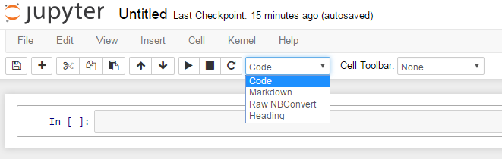
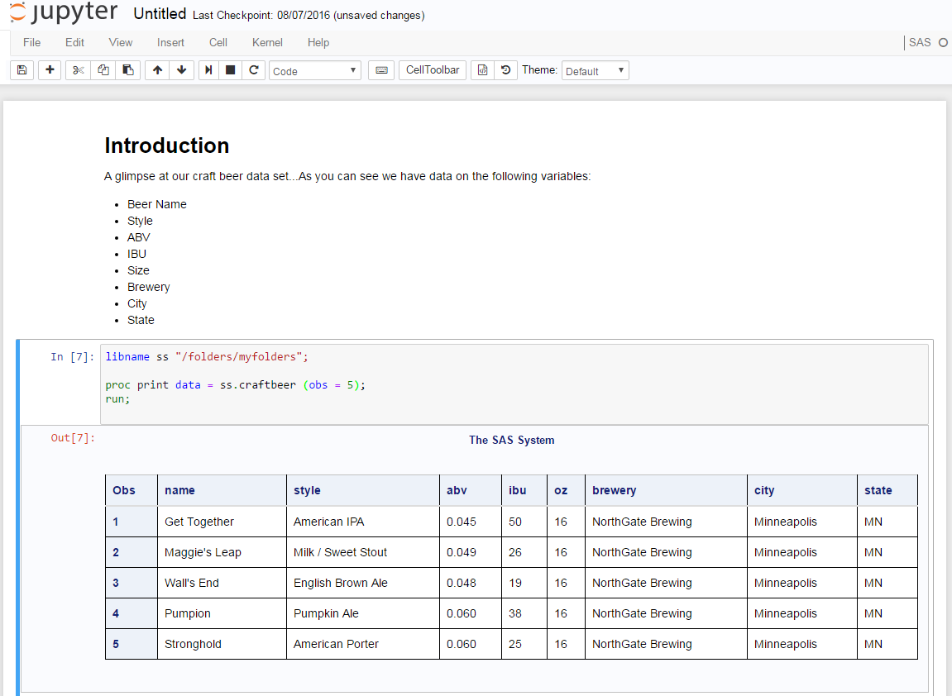
Project Jupyter
Notebook Tour Part VIII: Cell Types

Slide 23
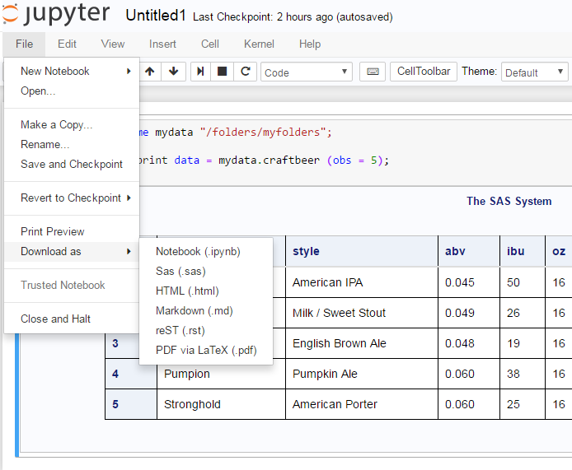
Project Jupyter
Notebook Tour Part IX: Save Types

Slide 24
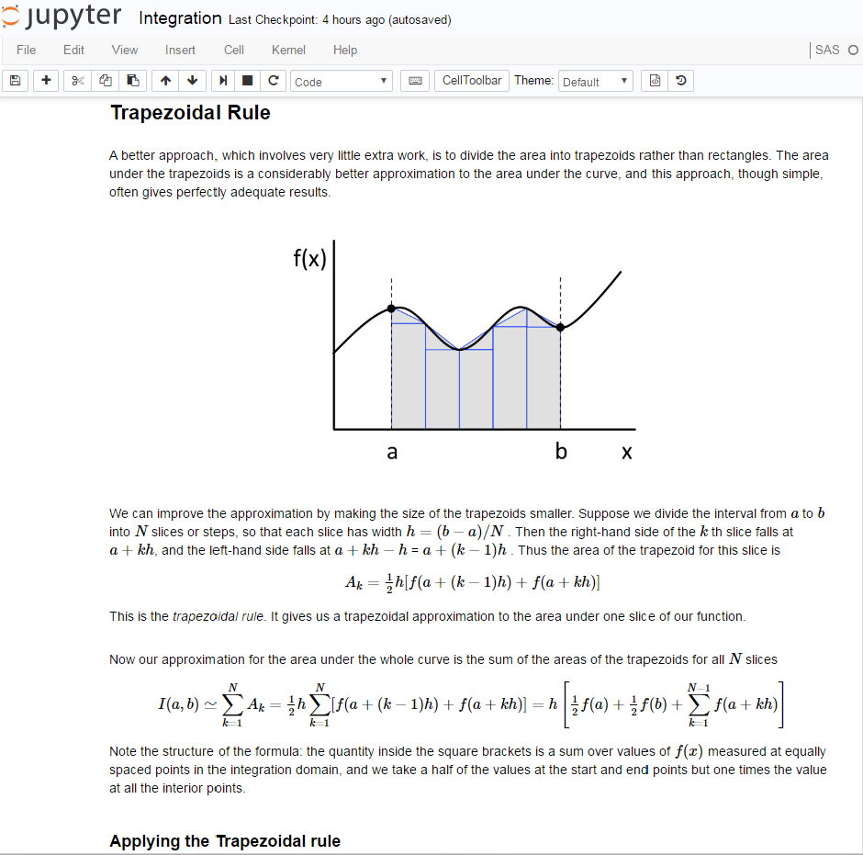

Project Jupyter
Notebook Tour Part X: Full Notebook

Slide 25
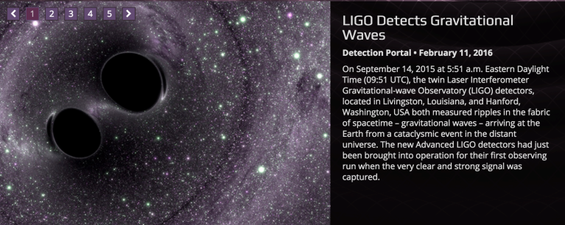
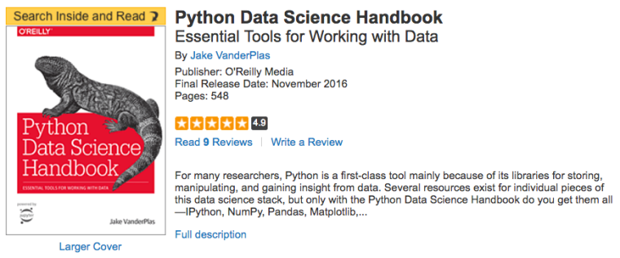
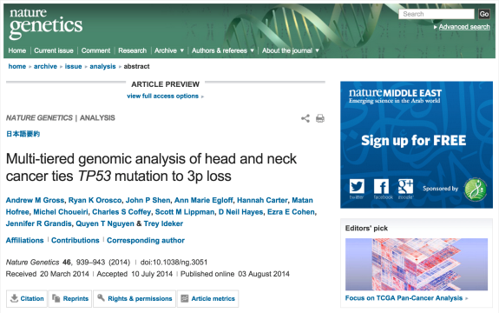
Usage in Publishing
All data along with full analysis as Juypter Notebooks.
O’Reilly media publishing books accompanied by Jupyter Notebooks.
Reproducible academic publications; articles accompanied by notebooks that reproduce results.

Slide 26
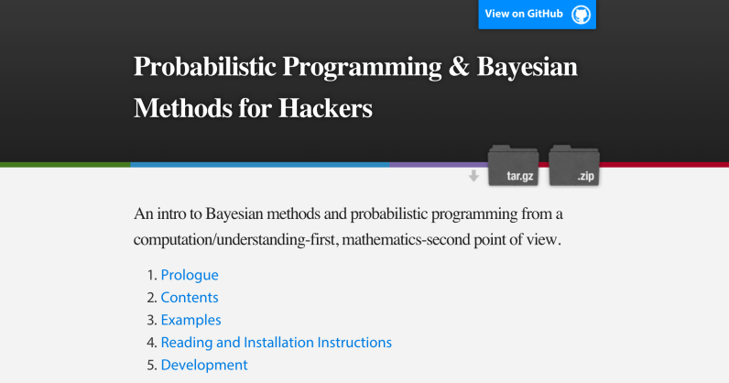
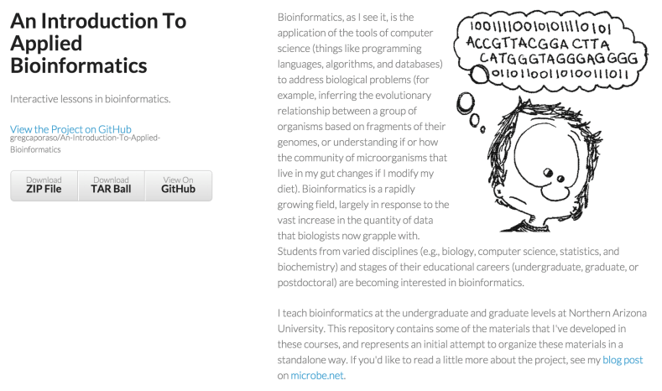
Usage in Curriculum
Textbooks are being written as sets of Jupyter Notebooks or with accompanying sets of Jupyter Notebooks.

Slide 27
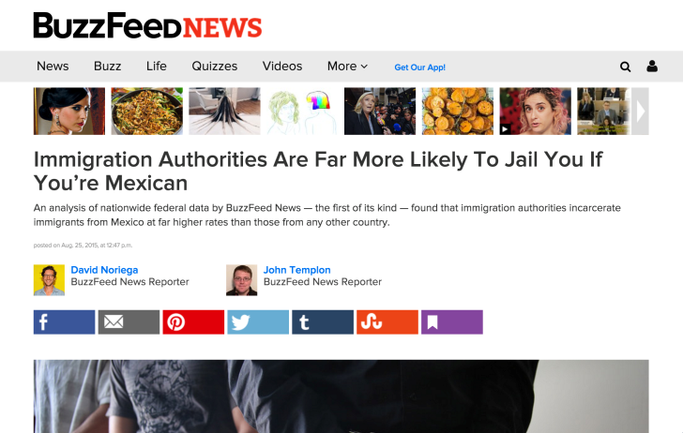
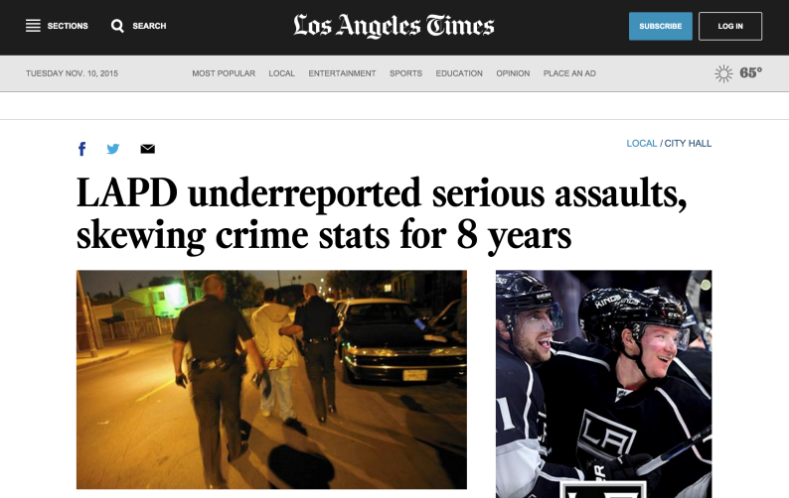
Usage in Data Journalism
Jeremy Singer-Vine and Jon Templon publish code and data for all data-backed articles they write for BuzzFeedNews.
LA Times article backed by significant analysis published on GitHub.

Slide 28
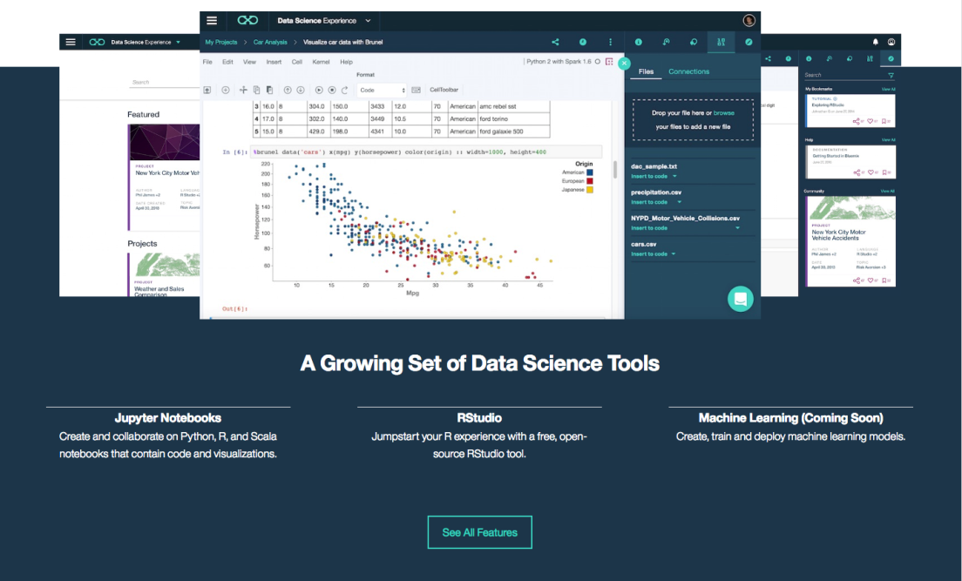
Usage in Commerical Products
IBM Data Science Experience
Quantopian Research Platform
Microsoft Notebooks, AzureML and HDInsight
dataiku Data Science Studio
DataRobot
Google Colaboratory
yhat Rodeo
Kaggle
And more!

Slide 29
Project Jupyter
Summary Part I
Web application enabling creation of documents that contain live code, equations, visualizations and explanatory text.
Over 40 languages are supported, including SAS now!
Code within the notebook can produce rich output such as images, videos, LaTeX and JavaScript.
Interactive widgets can be used to manipulate and visualize data in real time.

Slide 30
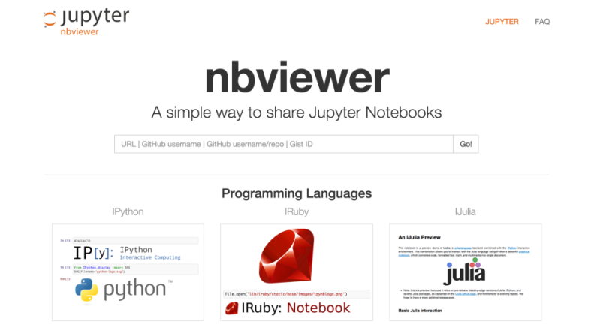
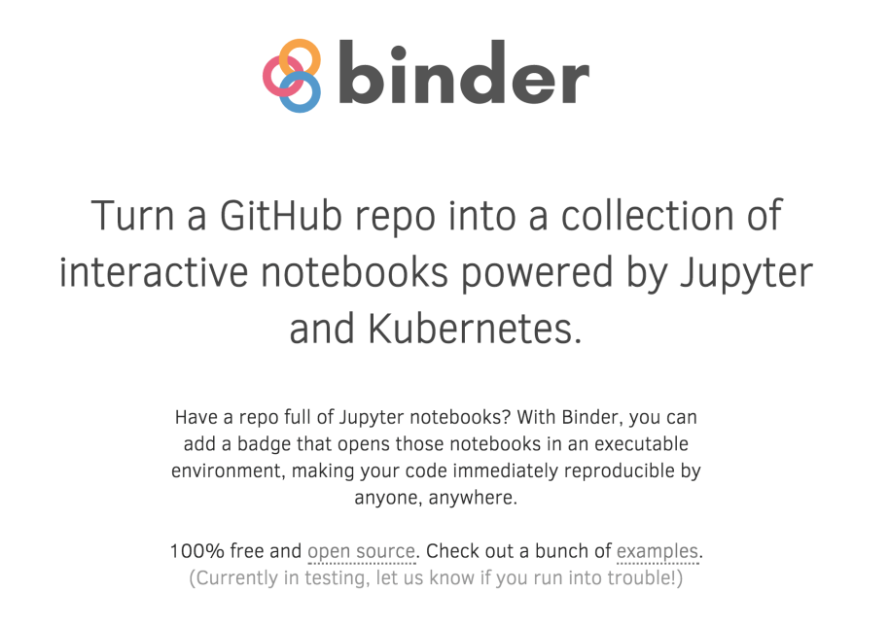
Project Jupyter
Summary Part II
Nbviewer
GitHub
Binder
JupyterHub

Slide 31
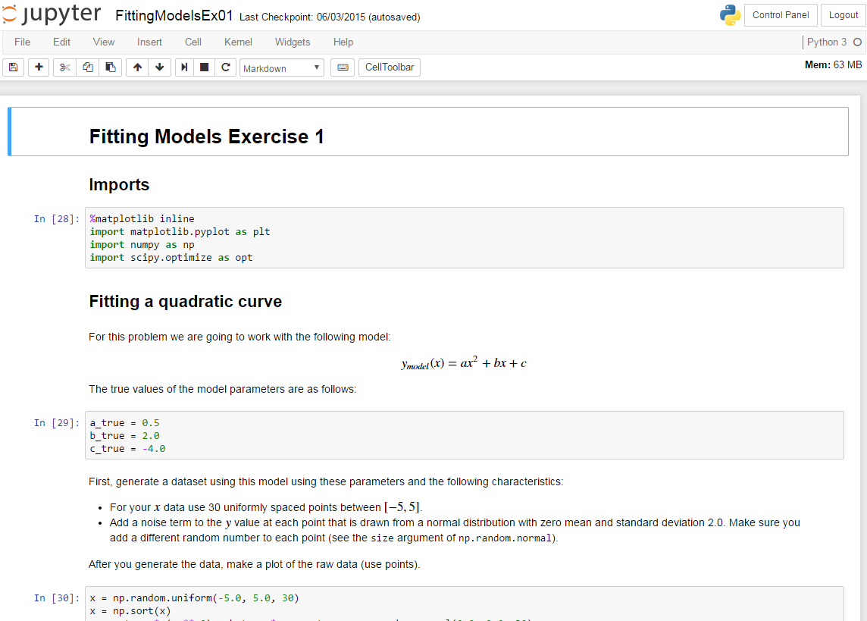
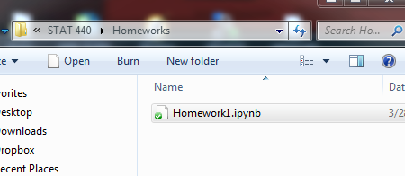
Statistical Computing with Jupyter
As an Undergraduate

Slide 32
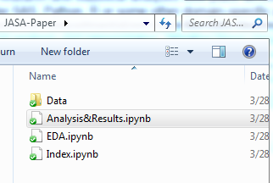
Statistical Computing with Jupyter
As a Graduate Student
As of Sept. 1, 2016, the Journal of the American Statistical Association: Applications and Case Studies requires code and data as a minimum standard for reproducibility of statistical scientific research.

Slide 33
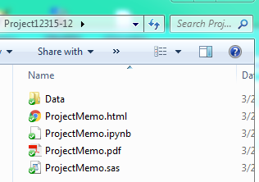
Statistical Computing with Jupyter
In Industry
Memo/report creation in sync with statistical work!
Suppress code cells

Slide 34


Statistical Computing with Jupyter
As an Educator Part I
Lecture materials
Course content
Why use two applications when one will do?!

Slide 35
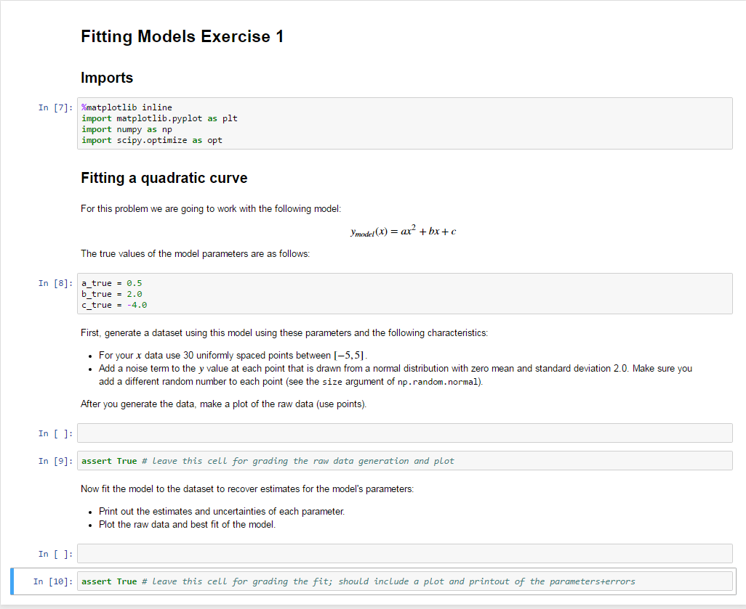
Statistical Computing with Jupyter
As an Educator Part II
Streamline assignments and grading

Slide 36
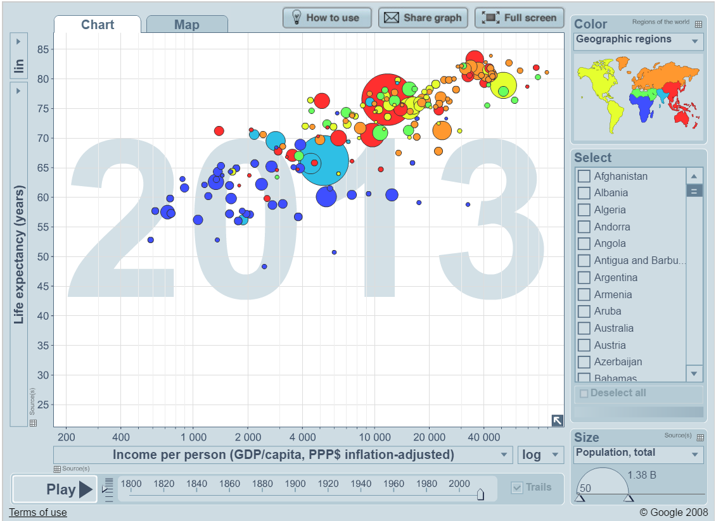

GapMinder Projects
EDA Project in SAS Part I
Students tasked with forming 6 research questions to answer using data on at least 12 variables from GapMinder.

Slide 37
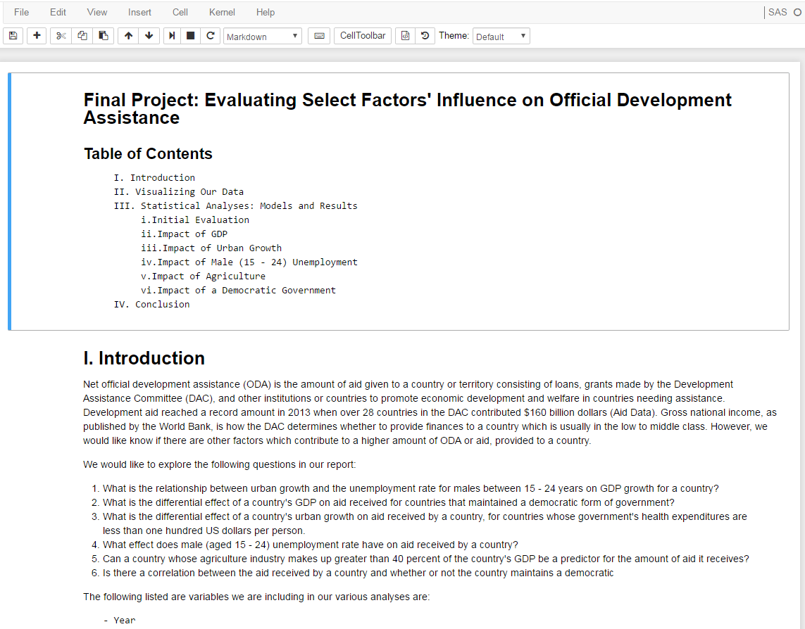
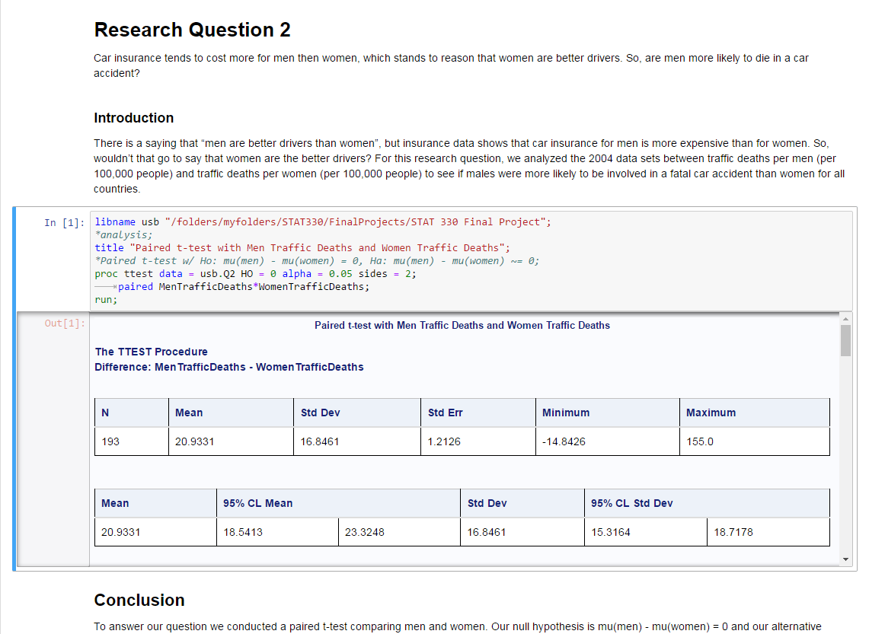
GapMinder Projects
EDA Project in SAS Part II

Slide 38
Conclusions
Part I: Ease of Use
From personal use to JupyterHub for organizations, Jupyter Notebooks make Statistical Computing easier to do AND share than every before!
“The need to minimize thought-to-execution friction is probably the single biggest productivity requirement in corporate America.”
Jupyter Notebooks let us take a GIANT leap toward achieving this when it comes to Data Science and Statistical Computing.

Slide 39
Conclusions
Part II: The Tool We Need and Deserve
Jupyter Notebook
A single vehicle for live code, text and images.
Dynamic documents that enhance Statistical Computing and Statistical Communication.
Streamline the analytics process
The color coding, formatting and organization of your favorite editor
Report writing capabilities
The integration and synthesis of these things into a single environment

Slide 40
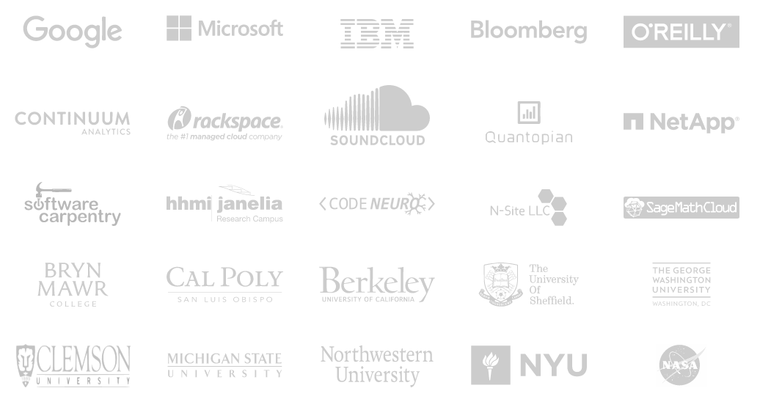
In Use At…
To name a few.

Slide 41
Recommendations
Students and professionals need to be trained in and using the tool in Data Science and Analytics: Jupyter Notebooks.
Increase efficiency, transparency and reproducibility
Support for Jupyter Notebooks should and will continue to grow as society continues to become more data-driven.

Slide 42
Thank You
Questions?

Slide 43
Thank you!
Contact Information hglanz@calpoly.edu
Reminder: Complete your session survey in the conference mobile app.

Slide 44


